Slide 1
IN CLASS PRESENTATION

Slide 2

ENAE788x COURAGE Rover
Justin Albrecht
Brian Bock
Prateek Bhargava
Sayani Roy

Slide 3
Overview
Project Requirements
Final Design (intro)
Terramechanics
Stability
Steering
Suspension
Power
Mass
Final Design (detailed)
Earth & Mars efficacy
Trafficability
Design Evolution and Concepts

Slide 4
Project Requirements
Project Description:
Perform a detailed design of a BioBot rover, emphasizing mobility systems
Chassis systems (e.g., wheels, steering, suspension…)
Support systems (e.g., energy storage)
Navigation and guidance system (e.g., sensors, algorithms...)
Design for Moon, then assess feasibility of systems for Mars, and conversion to Earth analogue rover
Requirements (Performance) :
Maximum operating speed of at least 4 m/sec on level, flat terrain.
Accommodate a 0.3 meter obstacle at minimal velocity.
Accommodate a 0.1 m obstacle at a velocity of 2.5 m/sec.
Accommodate a 20° slope in any direction at a speed of at least 1 m/sec and including the ability to start and stop.
A nominal sortie range of 54 km at an average speed of 2.5 m/sec.

Slide 5
Project Requirements
Requirements (Payload) :
Capable of carrying one 170 kg EVA crew and 80 kg of assorted payload
Payload may be modeled as a 0.25 m box
Capable of carrying a second 170 kg EVA crew in a contingency situation.
Incorporate roll-over protection for the crew and all required ingress/egress aids and crew restraints.
Requirements (Operations) :
A nominal sortie shall be at least eight hours long.
Two rovers must be launched on a single CLPS lander.
A single rover shall mass ≤250 kg.
Capable of operating indefinitely without crew present.
Requirements (GN&C) :
Capable of being controlled directly, remotely, or automated.
Capable of following an astronaut, astronaut’s path, or autonomous path planning between waypoints.
Capable of operating during any portion of the lunar day/night cycle and at any latitude.

Slide 6
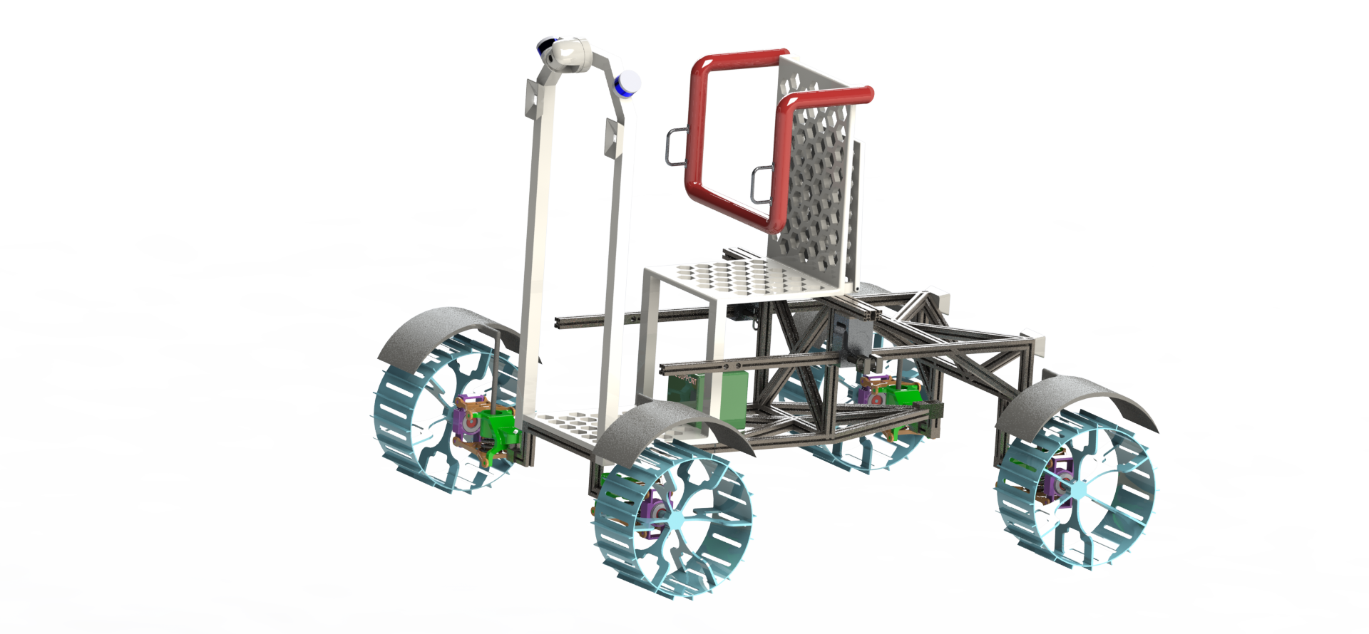
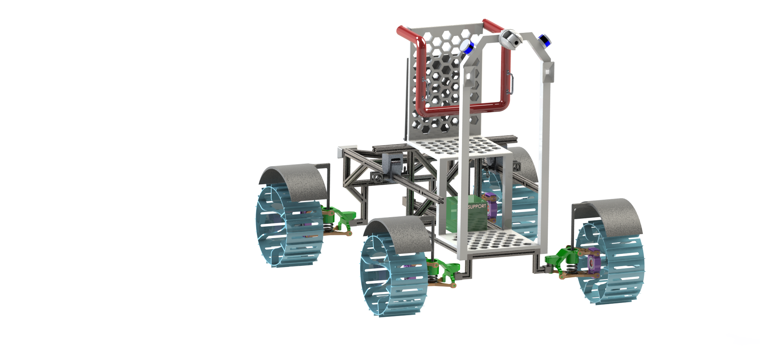
Courage Rover - Normal Use (Non Extended)

Slide 7
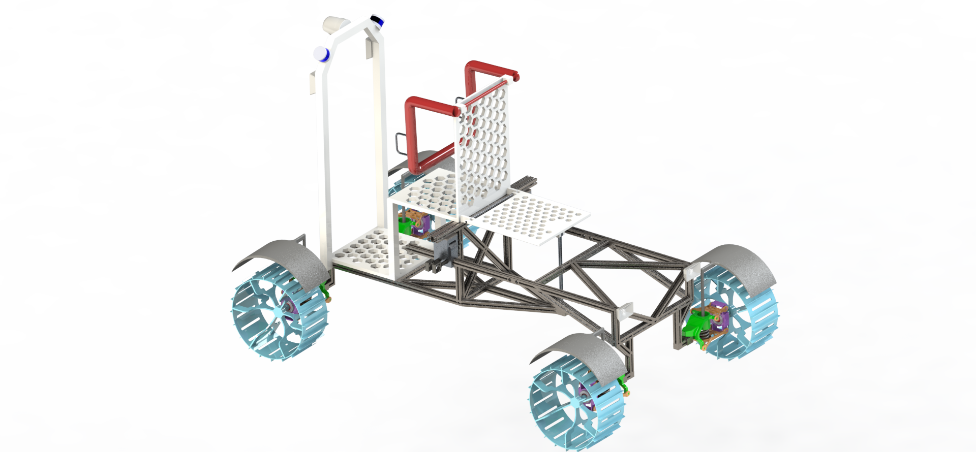
Courage Rover - Contingency Use (Extended)

Slide 8
Terramechanics

Slide 9
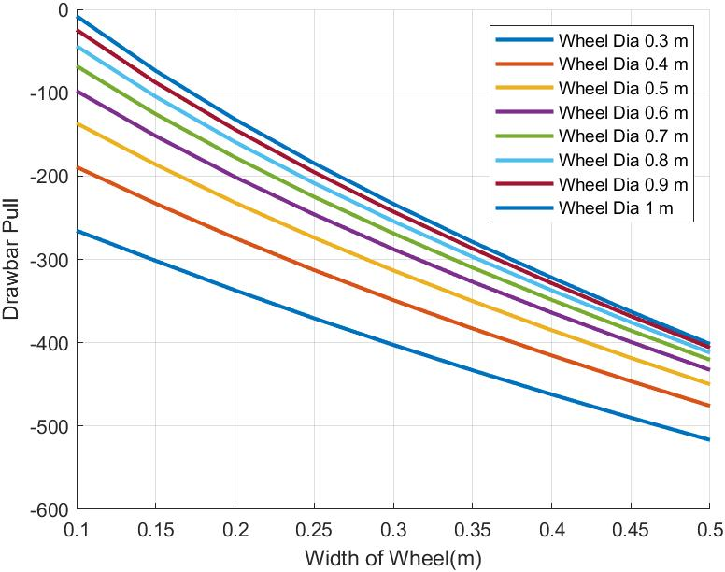
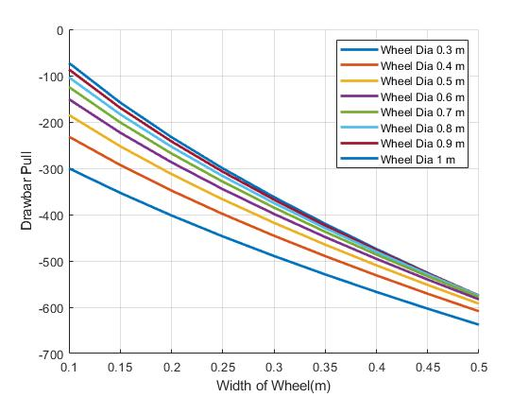
Trade Study - Drawbar Pull - No Grousers - Flat Terrain
4 Wheels
6 Wheels

Slide 10
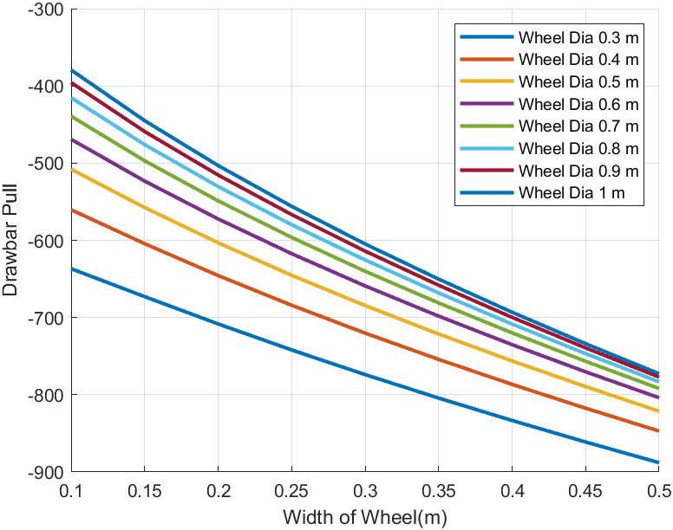
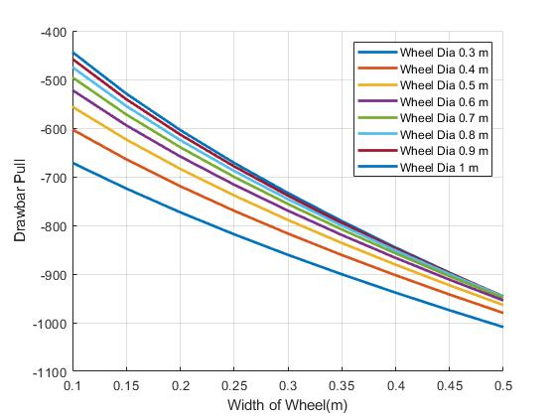
Trade Study - Drawbar Pull - No Grousers - 20 Slope
4 Wheels
6 Wheels

Slide 11
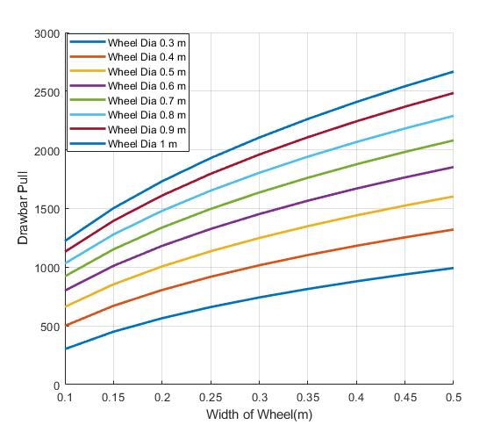
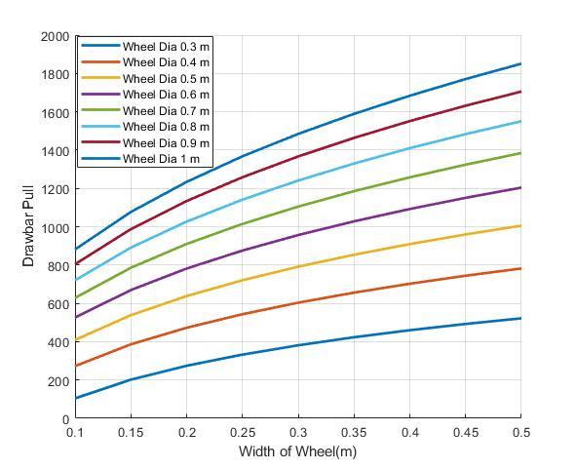
Trade Study - Drawbar Pull - Grousers - Flat
4 Wheels
6 Wheels

Slide 12
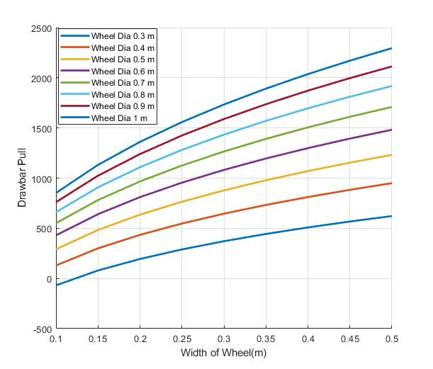
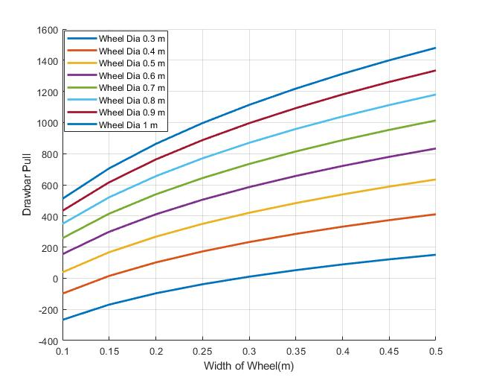
Trade Study - Drawbar Pull - Grousers - 20 Slope
4 Wheels
6 Wheels

Slide 13
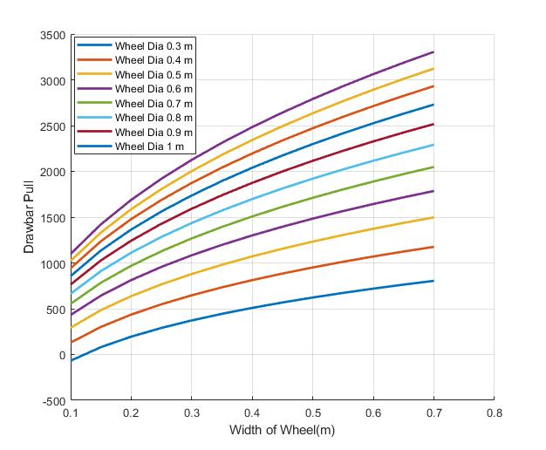
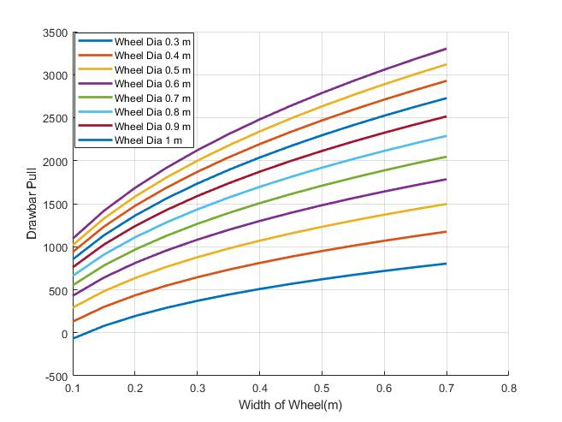


Drawbar Pull 4 Wheels - No. of Grousers
8
12
16
24

Slide 14
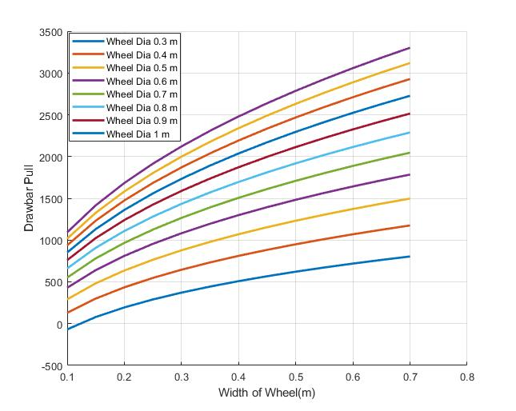
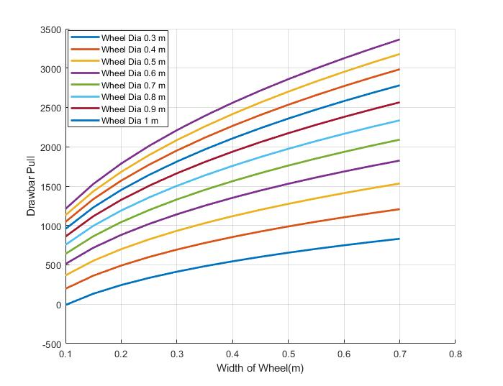
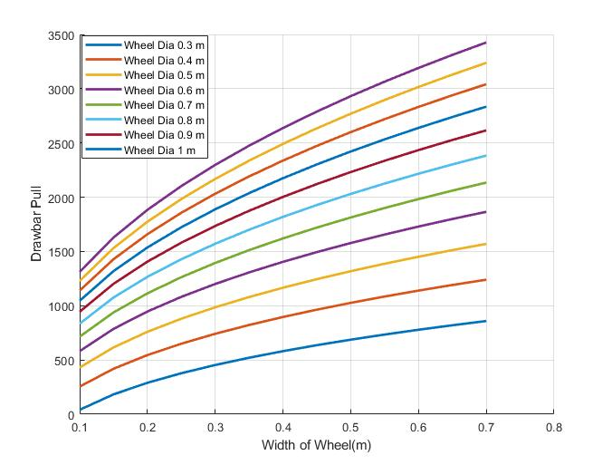
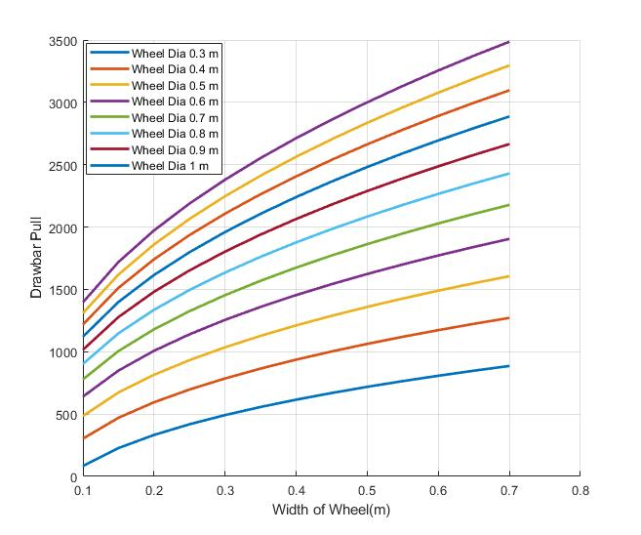
Drawbar Pull 4 Wheels - Height (cm)
2 cm
3 cm
4 cm
5 cm

Slide 15
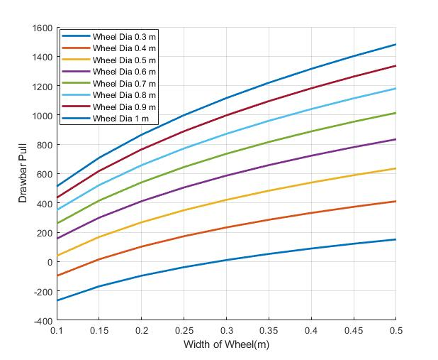
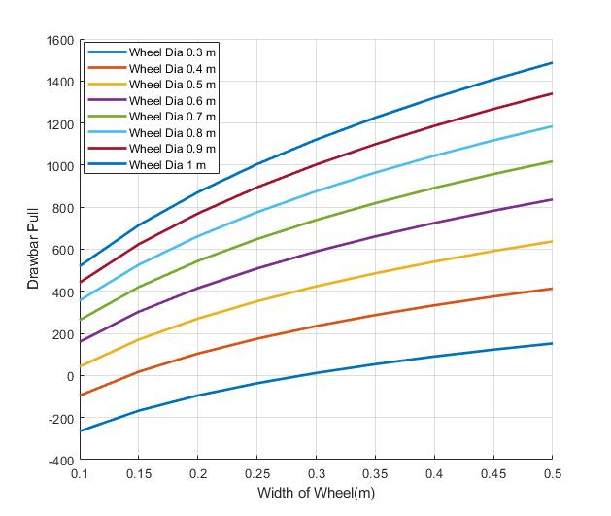

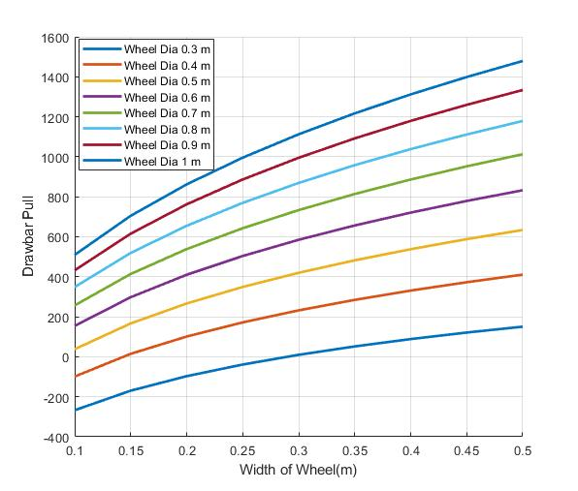
Drawbar Pull 6 Wheels - No. of Grousers
8
12
16
24

Slide 16
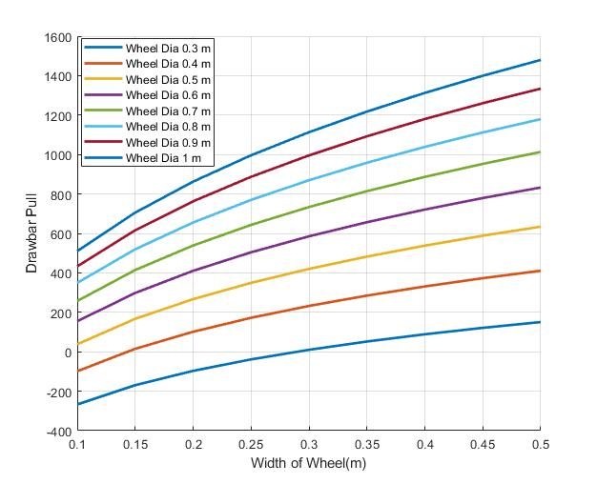
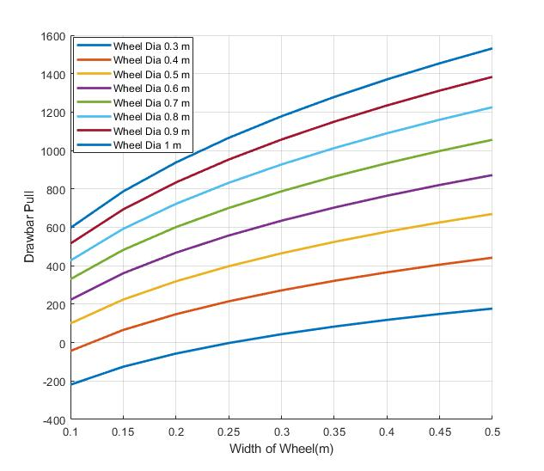
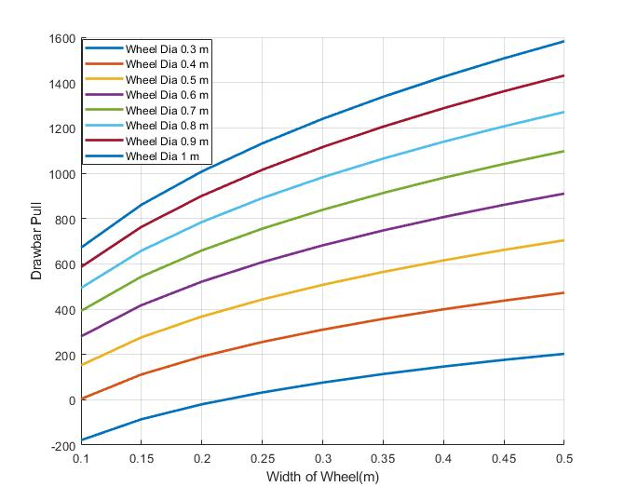
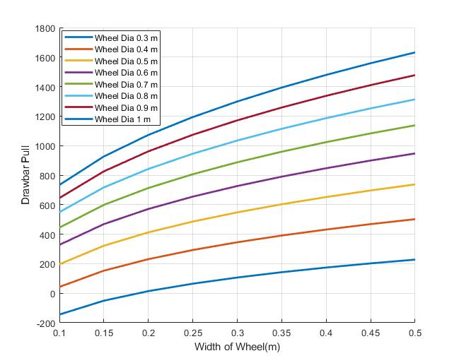
Drawbar Pull 6 Wheels - Height (cm)
2 cm
3 cm
4 cm
5 cm

Slide 17
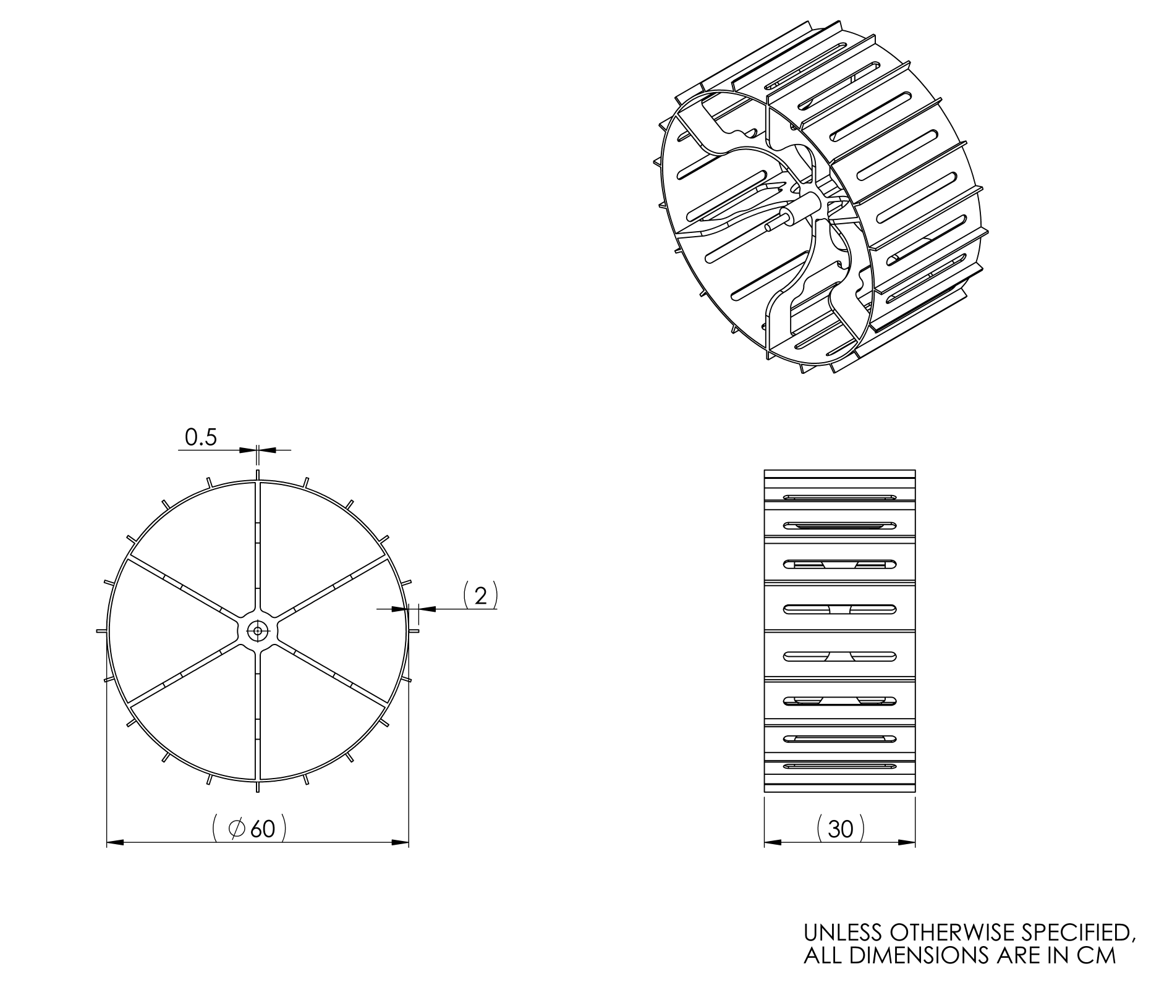
Wheel Drawing
Wheel Dimensions
Diameter | 60 cm
Width | 30 cm
Grouser Height | 2 cm
Number Spokes | 6

Slide 18
Terramechanics : Design Solution
From the above trade studies performed between 4 Wheels and 6 Wheels for diameter, width of wheels against drawbar pull, number of grousers and height of grousers; we have have chosen the following values:
Diameter of wheel(d) - 0.6 m
Width of wheel (w) - 0.3 m
Number of grousers - 20
Height of grousers - 0.02 m = 2 cm

Slide 19
Stability

Slide 20
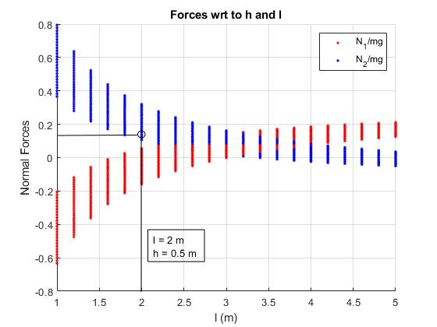
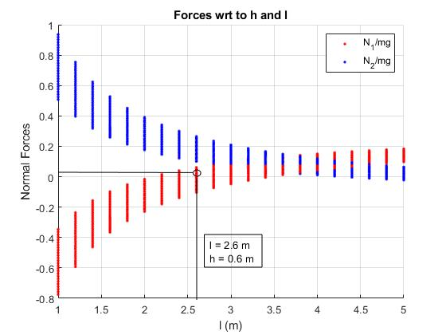
Stability - Forces wrt h and l
Non - Extended
Extended

Slide 21
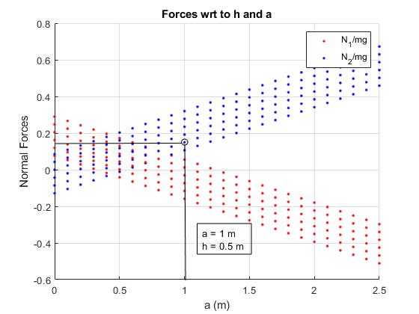
Stability - Forces wrt h and a
Non - Extended
Extended

Slide 22
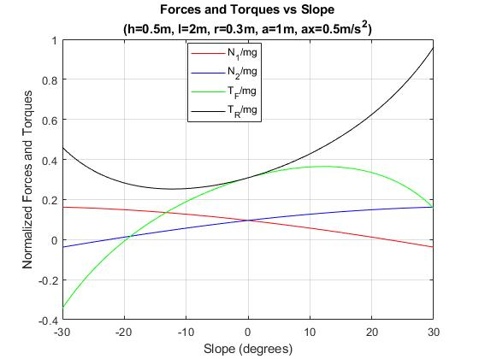
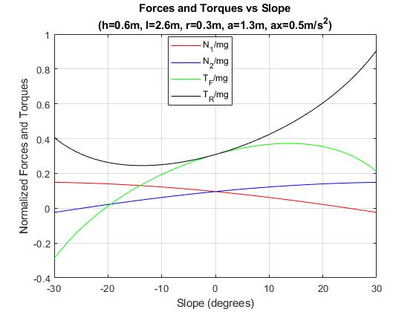
Slope Stability - Uphill / Downhill
Non - Extended
Extended

Slide 23
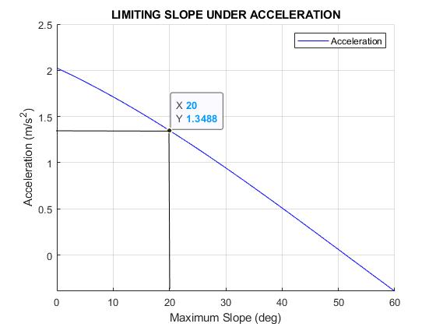
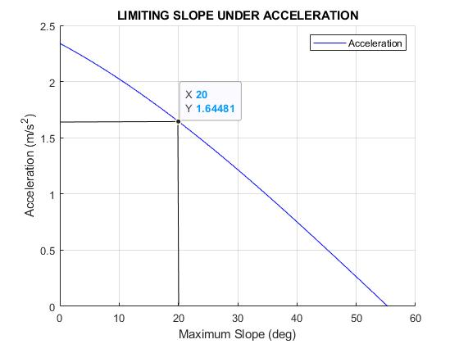
Acceleration Stability
Non - Extended
Extended

Slide 24
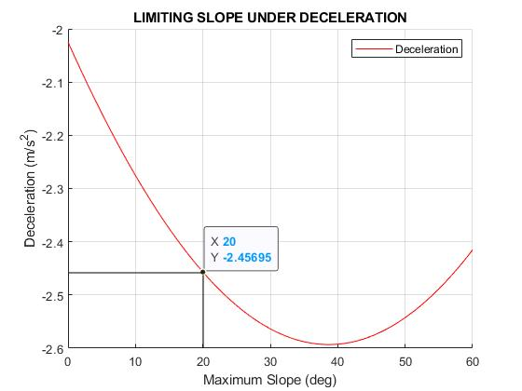
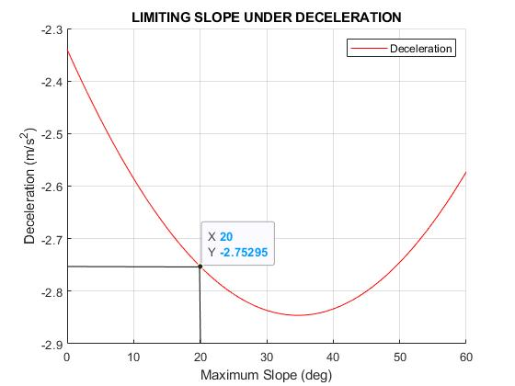
Deceleration Stability
Non - Extended
Extended

Slide 25
Stability - Design Solution
Non Extended - When the rover has only one EVA crew with an overall design mass of 500 kg.
Length of rover (l) - 2 m
Width of rover ( c ) - 1.6 m
Height of CoM (h) - 0.5 m
Length between front axle and CoM (a) - 1 m
Max Acceleration Rate (m/s²)
Flat Terrain - 2.025
Slope - 1.3488
Max Deceleration Rate (m/s²)
Flat Terrain - 2.025
Slope - 2.45695

Slide 26
Stability - Design Solution
2. Extended - When the rover has one EVA crew and one emergency EVA crew, for a total design mass of 670 kg.
Length of rover (l) - 2.6 m
Width of rover ( c ) - 1.6 m
Height of CoM (h) - 0.6 m
Length between front axle and CoM (a) - 1.3 m
Max Acceleration Rate (m/s²)
Flat Terrain - 2.34
Slope - 1.6481
Max Deceleration Rate (m/s²)
Flat Terrain - 2.34
Slope - 2.75295

Slide 27
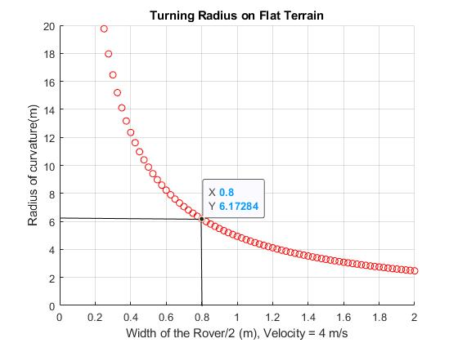
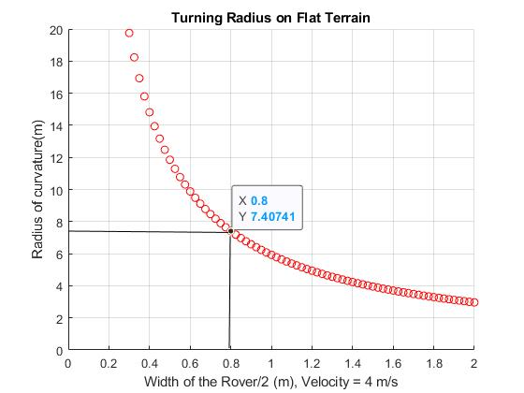
Turning Stability - 4 Wheels - Flat Terrain
Non - Extended
Extended

Slide 28
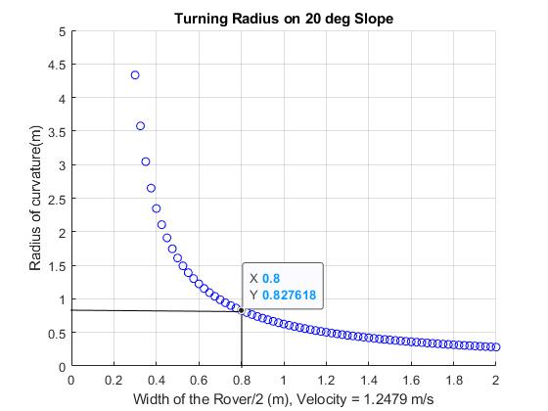
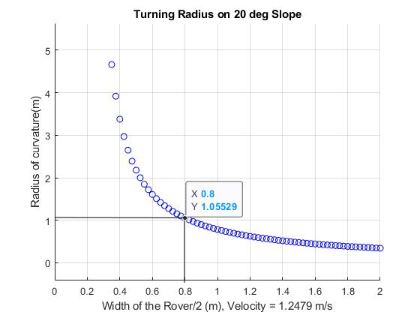
Turning Stability - 4 Wheels - Slope
Non - Extended
Extended

Slide 29
Steering

Slide 30
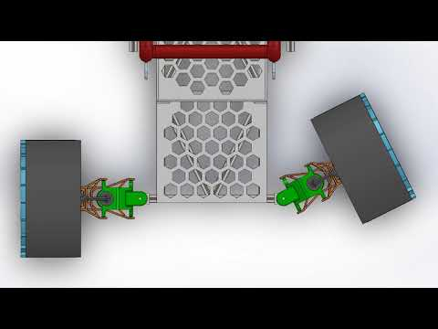
Steering Mechanism Design
Front two wheels are direct steered, each with a steering motor.
Rear wheels are fixed to the chassis
Notes:
https://youtu.be/GnRjyFgl60c

Slide 31
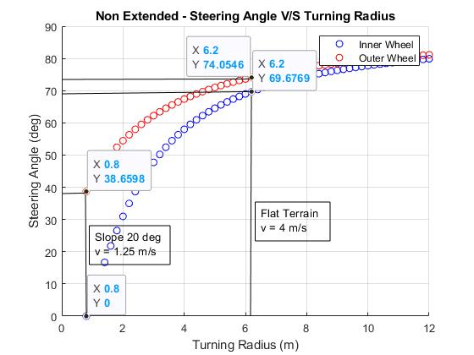
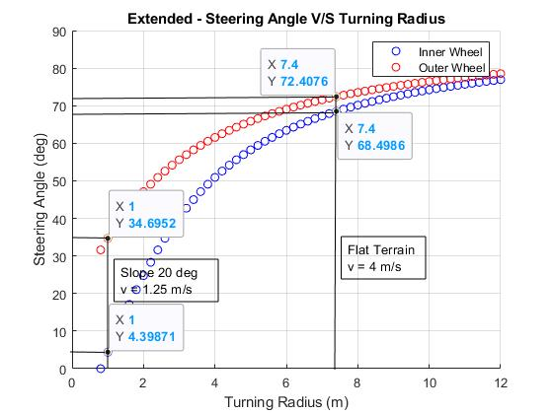
Steering Angle
Non - Extended
Extended

Slide 32
Suspension

Slide 33
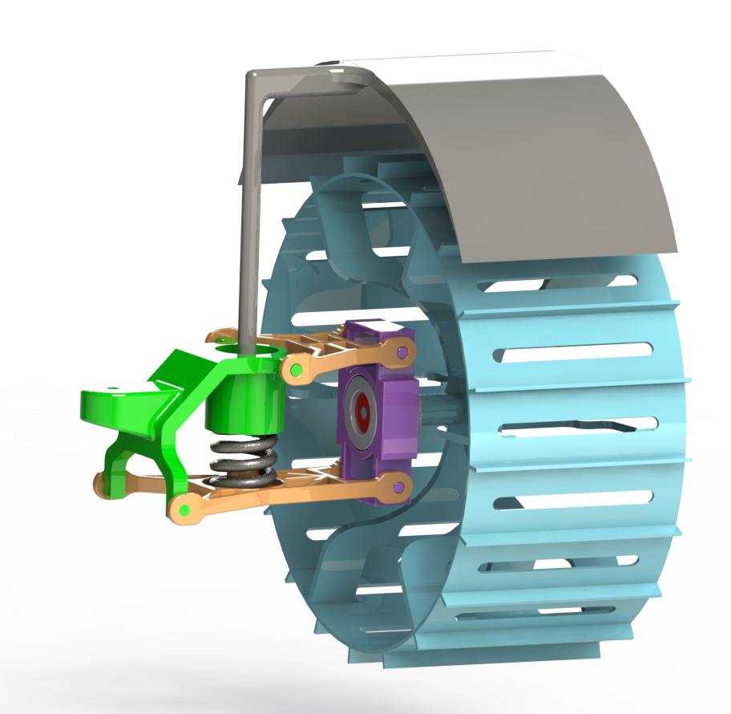
Suspension System
Mudguard
Upper wishbone
Wheel
Spring mount
Wheel hub mount
Steering motor (not shown)
Spring
Driving Motor
Lower wishbone

Slide 34
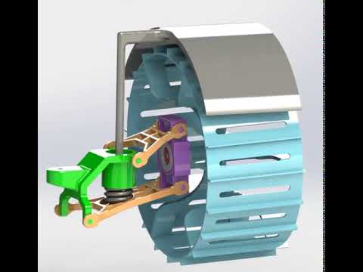
Suspension

Slide 35
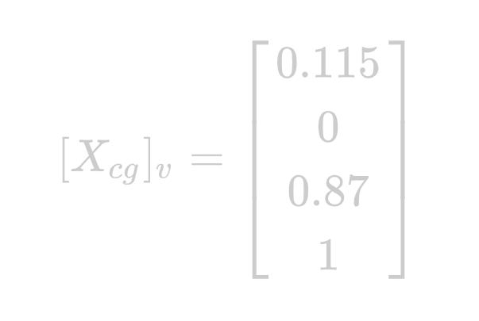
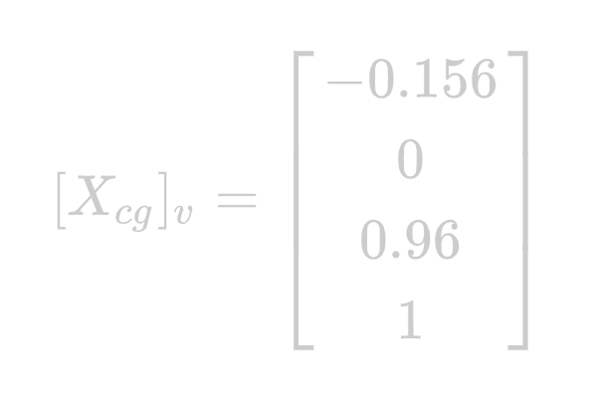
Suspension Statics
Using the method for N-wheeled independent suspension from class we can solve for weight distribution on each wheel including when wheels are on obstacles.
 | Standard | Extended
COM Offset
Total Weight | 682 N | 957 N
Length | 2 m | 2.6 m
Width | 1.6 m | 1.6 m

Slide 36
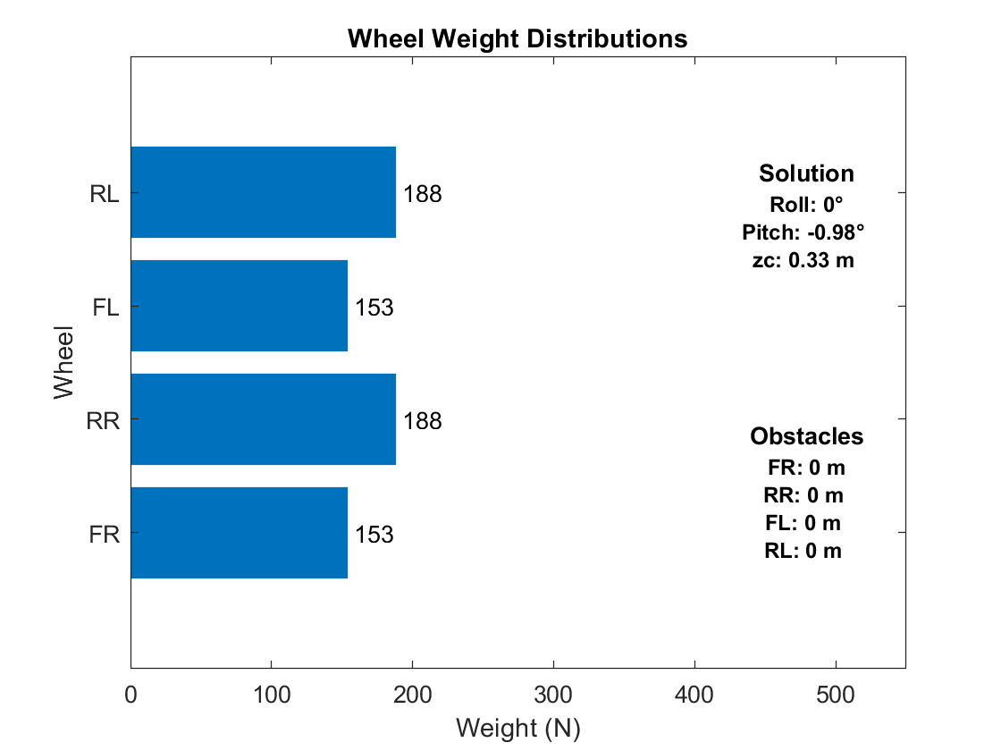
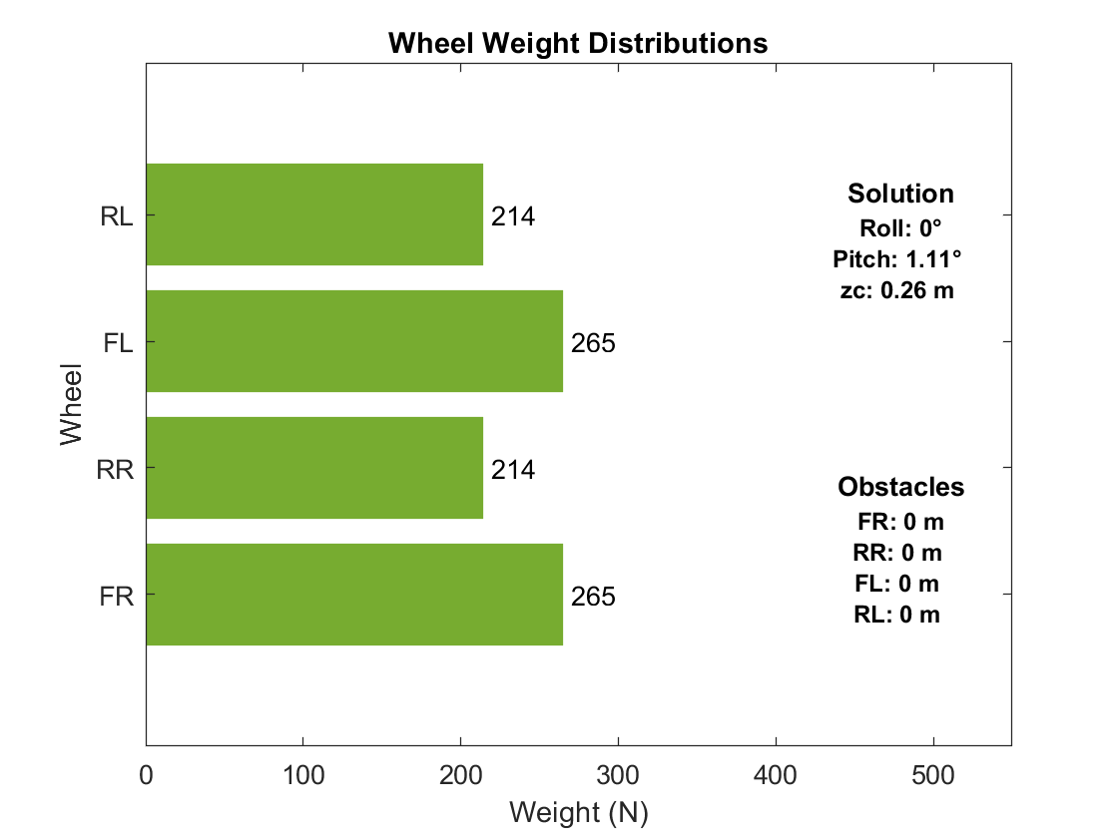
Weight Distributions on Flat Terrain
Standard Configuration
Extended Configuration

Slide 37
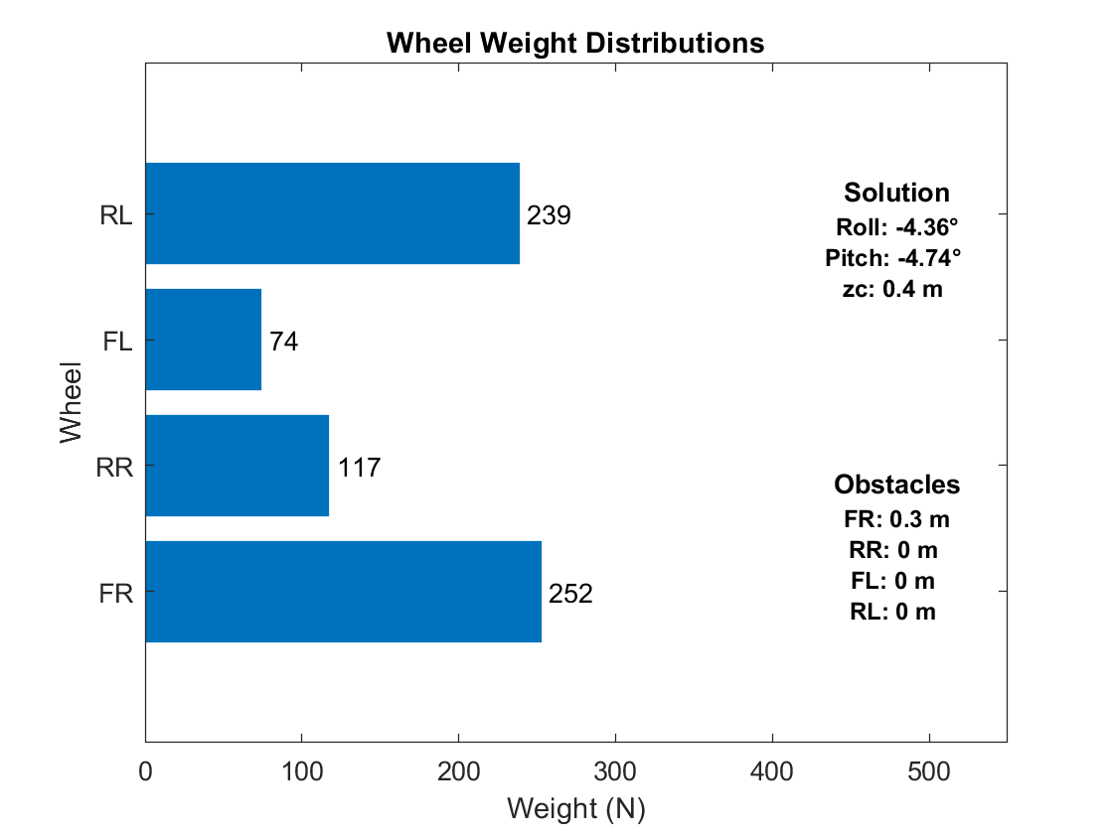
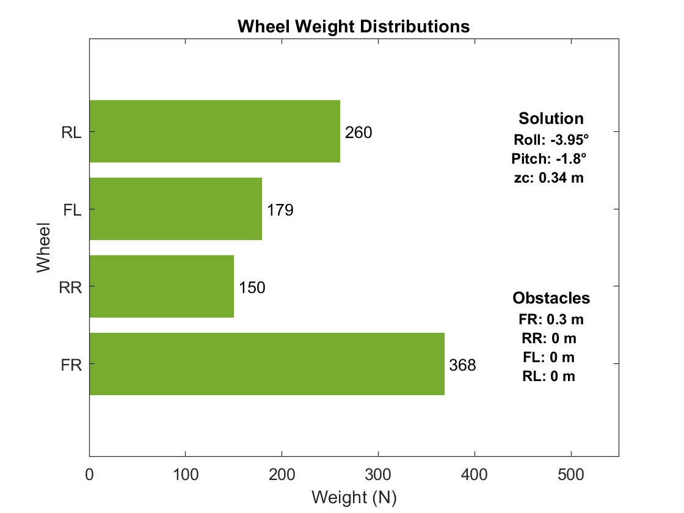
Weight Distributions (Front Right on Obstacle)
Standard Configuration
Extended Configuration

Slide 38
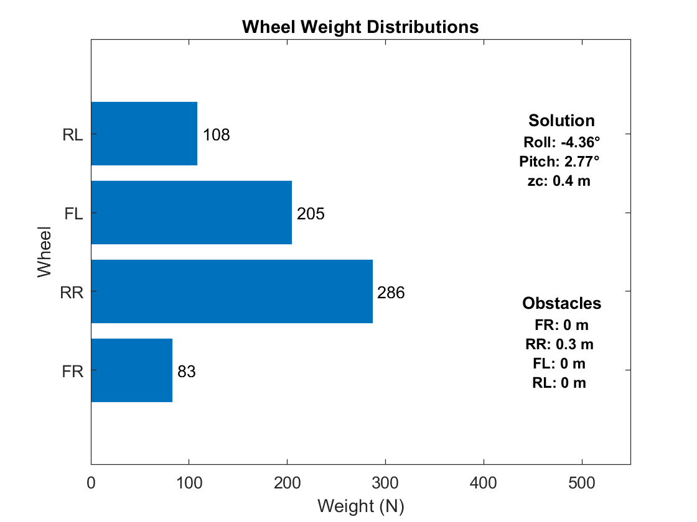

Weight Distributions (Rear Right on Obstacle)
Standard Configuration
Extended Configuration

Slide 39
Motors

Slide 40

Motors Trade-Study
Reference: Motor Comparison, Circuit Cellar Magazine, July 2008, Issue 216, Bachiochi, p.78

Slide 41


Drive Motor Requirements
As per velocity constraints, the rover requires a motor speed a little over 4000 rpm for a gear ratio of 200.
Motor increases with increase in wheel radius
For wheel radius = 0.3m, the motor torque required is around 1Nm when the gear ratio is 200.
Assuming, gear efficiency is 80%, we require a motor with torque around 1.25 Nm.

Slide 42


Power Ratio of Skid & Steer - Flat Terrain
Non - Extended
Extended

Slide 43


Power Ratio of Skid & Steer - Slope 20 deg
Non - Extended
Extended

Slide 44


Power - 4 Wheel Skid Turn
Non - Extended
Extended

Slide 45
Motor Requirements
Driving Motor
Brushless DC motors were chosen for wheel drive motors.
A motor from the RBE(H) 01212 series which complied with the torque and speed requirements was chosen.
Steering Motor
For each wheel steering, a motor with output power ~160 watts is required.
A motor from the RBE(H) 01212 series which complied with the power requirements was chosen.
https://npm-ht.co.jp/_assets/wp-content/uploads/2019/12/RBE_Series_Motors_Brochure_01210.pdf

Slide 46
Sensors & Perception

Slide 47



Lighting / LiDAR
4 LED Floodlights
35,000 lumens each
0.6kg each → 2.4kg total
30W each → 120W total
4 Velodyne Puck LITE
590g each → 2.4kg total
8W each → 32W total
https://velodynelidar.com/products/puck-lite

Slide 48



Cameras
2 Sony 4K PTZ cameras
1.8 kg each → 3.6 kg total
25W (max) each → 50W
4 stereo cameras
72g each → 288g
2W each → 8W
1 omni-directional camera (Go-Pro Max)
163g
8 W
https://www.digitalcameraworld.com/buying-guides/best-360-cameras
https://pro.sony/en_EE/product-resources/diagrams/brc-x400-3d-cad
https://store.intelrealsense.com/buy-intel-realsense-depth-camera-d455.html, https://www.intelrealsense.com/wp-content/uploads/2020/06/Intel-RealSense-D400-Series-Datasheet-June-2020.pdf

Slide 49
Computing
Autonomous path planning and full utilization of LiDAR + cameras requires non-trivial computing power.
Laptop style computer:
16GB RAM, 2.3GHz Quad Core CPU, 1.5GB Graphics
61W
1 kg
Desktop style computer:
64+GB RAM, 4.3GHz 8 core CPU, 8GB Graphics
650W
~6kg

Slide 50
Power

Slide 51


Slide 52

Power

Slide 53
Battery
18.5 kg of Tesla’s Model 3 Battery (260 Wh/kg)
OR 12 kg of Tesla’s planned battery (400 Wh/kg)
https://www.reuters.com/article/us-tesla-batteries/teslas-musk-hints-of-battery-capacity-jump-ahead-of-industry-event-idUSKBN25L0MC
Notes:
https://www.reuters.com/article/us-tesla-batteries/teslas-musk-hints-of-battery-capacity-jump-ahead-of-industry-event-idUSKBN25L0MC

Slide 54
Mass Summary

Slide 55

Mass Overview
Notes:
See https://docs.google.com/spreadsheets/d/15FFecJJcVnn86GBh3fDAZRVeVmlowi9YqHw2V7BU8T4/edit#gid=0

Slide 56

Mass Overview

Slide 57
Final Design

Slide 58
Courage Rover - Normal Use

Slide 59

Courage Rover - Normal Use

Slide 60

Courage Rover - Normal Use
Mass: 250.96kg
Power: 599 W
Driving Time: 8 hours assuming a 50% duty cycle for the drive motors.
Payload: one 80kg life support package, two 170kg astronauts
Max Speed: 4 m/s
Max Obstacle Size: 0.3m
Max Slope: 20 deg
Driving Modes: Autonomous [Drive to Destination], Autonomous [Follow Astronaut], Manual

Slide 61

Courage Rover - Normal Use

Slide 62

Courage Rover - Contingency Use
Notes:
https://youtu.be/2NqaSqYTE7E

Slide 63
Courage Rover - Contingency Use

Slide 64

Courage Rover - Contingency Use

Slide 65


Courage Rover - Contingency Use (Rear)

Slide 66

Courage Rover - Contingency Use

Slide 67

Courage Rover - Contingency Use

Slide 68

Ingress and Egress

Slide 69

Ingress and Egress
Notes:
https://youtu.be/CZCZPyoeBFo

Slide 70


Driving
Manual [Driven by Astronaut]
Wireless steering wheel + control panel
Autonomous [Drive to Destination]
VR Remote + AR HUD in suit
https://developer.oculus.com/blog/teleport-curves-with-the-gear-vr-controller/?locale=en_US
https://www.logitechg.com/en-gb/products/driving/driving-force-racing-wheel.html

Slide 71

Adherence to Requirements
Category | Required | Actual | Satisfied
Mass | ≤ 250 kg | 251 kg | - / -
Max Speed | 4 m/s | 4 m/s
Driving Speed/Range | Avg 2.5 m/s for 6 hours (54 km) | Avg 2 m/s for 8 hours (57.6km)
Max Obstacle Size | 0.3 m | 0.3 m
Max Slope | 20 degrees | 20 degrees
Payload (Normal) | 170 kg Astronaut + 80 kg payload | 170 kg Astronaut + 80 kg payload
Payload (Contingency) | Two 170 kg Astronauts + 80 kg payload | Two 170 kg Astronauts + 80 kg payload
Driving Modes | Autonomous, Follow Astronaut | Autonomous, Follow Astronaut, Manual

Slide 72
Earth & Mars Efficacy

Slide 73
Drawbar Pull Comparison
EARTH
MARS
g = 9.8 m/s² n = 0.5 k_{c} = 13190 N/m^{1.5} k_{ɸ} = 692200 N/m^{2.5} Assuming, K_{shear} = 13190 m Soil type = Clay
^{Drawbar pull = 6154.99 N}
g = 3.711 m/s² n = 1 k_{c} = 28000 N/m² k_{ɸ} = 7600000 N/m³ Assuming, K_{shear} = 13190 m Soil type = Sandy Loam
^{Drawbar pull = 968.26 N}
g = 3.711 m/s² n = 0.8 k_{c} = 6800 N/m² k_{ɸ} = 210000 N/m³ Assuming, K_{shear} = 13190 m Soil type = Slope soil
^{Drawbar pull = 7713.51 N}

Slide 74

Stability check (Earth)
Design is still valid for Earth environment.
Uphill slope limit is more than 30 degrees.
Downhill slope is less than 10 degrees.

Slide 75

Stability check (Mars)
Design is still valid for Mars environment.
Uphill slope limit is more than 30 degrees.
Downhill slope is more than 10 degrees.

Slide 76


Turning Radius on Flat Terrain: Earth & Mars
EARTH
MARS

Slide 77


Turning Radius on 20º Slope: Earth & Mars
EARTH
MARS

Slide 78
Trafficability

Slide 79

20 Degree Slope - Downhill

Slide 80

20 Degree Slope - Downhill

Slide 81

20 Degree Slope - Downhill

Slide 82

20 Degree Slope - Downhill

Slide 83

20 Degree Slope - CoM

Slide 84

20 Degree Slope - Uphill

Slide 85

20 Degree Slope - Uphill

Slide 86

20 Degree Slope - Sideways

Slide 87

20 Degree Slope - Sideways

Slide 88

0.1m Obstacle

Slide 89

0.1m Obstacle

Slide 90

0.1m Obstacle

Slide 91

0.3m Obstacle

Slide 92

0.3m Obstacle

Slide 93

0.1m & 0.3m Obstacle

Slide 94
Design Evolution
3. “Design is an iterative process. The necessary number of iterations is one more than the number you have currently done. This is true at any point in time.
4. Your best design efforts will inevitably wind up being useless in the final design.”
-Akin’s Laws of Spacecraft Design

Slide 95

Concept - Mk1 Rover
Sensor arch with Velodyne LiDAR pucks, flood lights, and several PTZ cameras (not shown). Configurations with 2 or 3 sensor arches are also possible with this design
Umbilical management system
Roller coaster style seat restraint

Slide 96

Concept - Horsebot
80kg life support payload
Bio-inspired legged locomotion
Hip rotation joint (not shown)
Four 4 DoF legs

Slide 97

Concept - Horsebot
Foldable seat in rear for second astronaut
0.3m obstacle

Slide 98
Concept - Horsebot - Pros
Legged locomotion easily clears any obstacle
Works well on rugged/uneven terrain
360° rotation hip joint allows Horsebot to walk sideways (or at arbitrary angle) with its standard gait
Easy to incorporate second rider
Seat position keeps center of mass relatively low
Novel and interesting

Slide 99
Concept - Horsebot - Cons
Legs are more complex than wheels (more ways to fail)
Legs require more actuators (more weight)
4 m/s would require a medium trot/slow gallop gait, which are only dynamically stable
Trot/Gallop gait requires much faster and higher torque motors (more weight, more power)
Additional DoFs (ex: hip abduction, ankle pronation) might be needed for walking on slopes

Slide 100
Concept - Wheeled Horsebot
Similar to the Horsebot shown in previous slides, this concept includes wheels (mounted on either the ankles or knees) for a reconfigurable driving configuration. Obstacle avoidance would be done at slow speeds with a walking gait, while normal (higher speed) travel on smooth ground would be done with the wheels. This reduces the need for high speed/torque motors for a gallop/trot gait, but requires an additional motor for each wheel. The leg motors act as electromechanical suspension in driving mode.
The increased weight from the extra motors makes this concept impractical for this mission

Slide 101



Concept - Strandbeest Locomotion
Locomotion inspired by Theo Jansen’s Strandbeests and other similar designs
https://www.newmobility.com/2013/07/walking-wheelchair-with-12-legs/
https://www.hackster.io/fx4u/strandbeest-a-robotic-project-7e1e23
https://www.newmobility.com/2018/09/spider-chair/

Slide 102
Concept - Strandbeest Locomotion - Pros
Concept - Strandbeest Locomotion - Cons
Legs can be actuated with very few motors
Chair centric design is compact and relatively lightweight (center photo on previous slide is 96 kg)
Novel and interesting design
Very high mechanical complexity (many ways to fail)
Well tested on sand, but not well tested on rugged/uneven terrain
Largely incompatible with stair climbing (due to leg lengths)

Slide 103


Concept - 6 Wheel w/ Extension
(wheels not shown)

Slide 104
Concept - 6 Wheels w/ Extension
This concept involves a 6 wheel rover with two possible configurations. In the normal driving mode, the rear 4 wheels are close together and act as tandem wheels. In the contingency configuration, the chassis extends to provide a wider base so the shifted center of mass (due to the second astronaut) is still centered (front/back) on the rover. In its original implementation, this extension would be actuated via a hand crank which turned a pinion to move the rack (the extender). Subsequent iterations on this design used two extending beams (as shown on the previous slide) for improved stability, as well as an additional pivot (orange, on the previous slide), allowing for the rear wheels to not be coplanar with the rest of the rover (ex: exiting a hill)

Slide 105

Crank Actuated Extension

Slide 106
Structure

Slide 107

Strength Analysis - Rear Arch Cross Beam
F
F
F=670kg*1.62m/s²*0.5
L=1.5m
a=0.25m
a
a
L
x
https://mechanicalc.com/reference/beam-analysis

Slide 108

45-9090 Type Aluminum Extrusion
Young’s Modulus=70*10⁹ Pa
I = 179.4968 cm⁴
A = 20.014 cm²
Total Mass: 8.104 kg
Max Deflection (@x=L/2): 0.29 mm
https://8020.net/45-9090.html#

Slide 109

45-4545 Lite Titanium Extrusion
Young’s Modulus=170*10⁹ Pa
I = 9.2029 cm⁴
A = 5.167 cm²
Total Mass: 3.49 kg
Max Deflection (@x=L/2): 3.3mm
https://8020.net/45-4545-lite.html

Slide 110

Extension Mechanism - Original
Rack and pinion on a truss, actuated with a hand crank
Hinged - back wheels can rotate up/down for improved surface contact
12.7kg each
(2 required)
Locking pin with a hitch pin to lock the assembly for driving

Slide 111

Extension Mechanism - Simplified for Weight
Sliding 45-4545-Lite Titanium beam on rollers, actuated by reversing rear wheels
5.8kg each
(2 required)
Locking pin with a hitch pin to lock the assembly for driving
Hinged - back wheels can rotate up/down for improved surface contact

Slide 112
Extension Mechanism
This extension mechanism revision was done when the rover still had arched chasses. The benefit of the weight savings in switching profiles and materials far exceeded the small decrease in structural strength. The sliding mechanism is now actuated by driving the rear wheels in reverse (and/or also driving the front wheels forward) to separate the two chassis halves.
Later revisions on this concept continue to use the titanium sliding beam, but offer additional reinforcement elsewhere in the structure (various braces and cross beams) and a much stronger pivot mechanism. The sliding box includes small rollers on the inside (like a skate wheel conveyor) to minimize friction.

Slide 113

6 Wheel Rover, Chassis Arches
Notes:
The middle two wheels in the 6 wheel design were excluded were our stability calculations (as well as other evaluations) and we realized that these two wheels contributed little except additional driving power and structural stability. Evaluating a 4 wheel rover proved much simpler than trying to evaluate a 6 wheel rover, and the middle two wheels (and entire middle chassis assembly) were discarded.

Slide 114

4 Wheel Rover, Chassis Arches

Slide 115


4 Wheel Rover, Flat Chassis
Notes:
The chassis arches were designed to get the rover body higher off the ground so that it wouldn’t catch on obstacles. However, our wheel design places the wheel hub 0.3m above the ground, so any chassis flush with or slightly above the wheel axles would satisfy this obstacle avoidance requirement. This next iteration of the design focuses on a much flatter chassis for simplicity and strength. This would become our final design, with additional braces and structural reinforcement for improved rigidity and strength.

Slide 116


4 Wheel Rover, Flat Chassis (Final)

Slide 117
Thank You!

Slide 118
Thank You!

Slide 119
TOTAL SLIDE DECK

Slide 120
Thank You!

Slide 121
Thank You!

Slide 122
Thank You!

Slide 123
ENAE788x COURAGE Rover
Justin Albrecht
Brian Bock
Prateek Bhargava
Sayani Roy

Slide 124
Project Requirements
Project Description:
Perform a detailed design of a BioBot rover, emphasizing mobility systems
Chassis systems (e.g., wheels, steering, suspension…)
Support systems (e.g., energy storage)
Navigation and guidance system (e.g., sensors, algorithms...)
Design for Moon, then assess feasibility of systems for Mars, and conversion to Earth analogue rover
Requirements (Performance) :
Maximum operating speed of at least 4 m/sec on level, flat terrain.
Accommodate a 0.3 meter obstacle at minimal velocity.
Accommodate a 0.1 m obstacle at a velocity of 2.5 m/sec.
Accommodate a 20° slope in any direction at a speed of at least 1 m/sec and including the ability to start and stop.
A nominal sortie range of 54 km at an average speed of 2.5 m/sec.

Slide 125
Project Requirements
Requirements (Payload) :
Capable of carrying one 170 kg EVA crew and 80 kg of assorted payload
Payload may be modeled as a 0.25 m box
Capable of carrying a second 170 kg EVA crew in a contingency situation.
Incorporate roll-over protection for the crew and all required ingress/egress aids and crew restraints.
Requirements (Operations) :
A nominal sortie shall be at least eight hours long.
Two rovers must be launched on a single CLPS lander.
A single rover shall mass ≤250 kg.
Capable of operating indefinitely without crew present.
Requirements (GN&C) :
Capable of being controlled directly, remotely, or automated.
Capable of following an astronaut, astronaut’s path, or autonomous path planning between waypoints.
Capable of operating during any portion of the lunar day/night cycle and at any latitude.

Slide 126
Terramechanics

Slide 127
Trade Study - Drawbar Pull - No Grousers - Flat Terrain
4 Wheels
6 Wheels

Slide 128
Trade Study - Drawbar Pull - No Grousers - 20 Slope
4 Wheels
6 Wheels

Slide 129
Trade Study - Drawbar Pull - Grousers - Flat
4 Wheels
6 Wheels

Slide 130
Trade Study - Drawbar Pull - Grousers - 20 Slope
4 Wheels
6 Wheels

Slide 131
Drawbar Pull 6 Wheels - No. of Grousers
8
12
16
24

Slide 132
Drawbar Pull 6 Wheels - Height (cm) : 2 vs. 3 vs. 4 vs. 5
2 cm
3 cm
4 cm
5 cm

Slide 133
Wheel Drawing
Wheel Dimensions
Diameter | 60 cm
Width | 30 cm
Grouser Height | 2 cm
Number Spokes | 6

Slide 134
Terramechanics : Design Solution
From the above trade studies performed between 4 Wheels and 6 Wheels for diameter, width of wheels against drawbar pull, number of grousers and height of grousers; we have have chosen the following values:
Diameter of wheel(d) - 0.6 m
Width of wheel (w) - 0.3 m
Number of grousers - 20
Height of grousers - 0.02 m = 2 cm

Slide 135
Stability

Slide 136
Stability - Forces wrt h and l
Non - Extended
Extended

Slide 137
Stability - Forces wrt h and a
Non - Extended
Extended

Slide 138
Slope Stability - Uphill / Downhill
Non - Extended
Extended

Slide 139
Acceleration Stability
Non - Extended
Extended

Slide 140
Deceleration Stability
Non - Extended
Extended

Slide 141
Stability - Design Solution
Non Extended - When the rover has only one EVA crew with an overall design mass of 500 kg.
Length of rover (l) - 2 m
Width of rover ( c ) - 1.6 m
Height of CoM (h) - 0.5 m
Length between front axle and CoM (a) - 1 m
Max Acceleration Rate (m/s²)
Flat Terrain - 2.025
Slope - 1.3488
Max Deceleration Rate (m/s²)
Flat Terrain - 2.025
Slope - 2.45695

Slide 142
Stability - Design Solution
2. Extended - When the rover has one EVA crew and one emergency EVA crew, for a total design mass of 670 kg.
Length of rover (l) - 2.6 m
Width of rover ( c ) - 1.6 m
Height of CoM (h) - 0.6 m
Length between front axle and CoM (a) - 1.3 m
Max Acceleration Rate (m/s²)
Flat Terrain - 2.34
Slope - 1.6481
Max Deceleration Rate (m/s²)
Flat Terrain - 2.34
Slope - 2.75295

Slide 143
Turning Stability - 4 Wheels - Flat Terrain
Non - Extended
Extended

Slide 144
Turning Stability - 4 Wheels - Slope
Non - Extended
Extended

Slide 145
Suspension

Slide 146
Suspension System
Mudguard
Upper wishbone
Wheel
Spring mount
Wheel hub mount
Steering motor (not shown)
Spring
Driving Motor
Lower wishbone

Slide 147
Suspension

Slide 148
Suspension Statics
Using the method for N-wheeled independent suspension from class we can solve for weight distribution on each wheel including when wheels are on obstacles.
 | Standard | Extended
COM Offset
Total Weight | 682 N | 957 N
Length | 2 m | 2.6 m
Width | 1.6 m | 1.6 m

Slide 149
Weight Distributions on Flat Terrain
Standard Configuration
Extended Configuration

Slide 150
Weight Distributions (Front Right on Obstacle)
Standard Configuration
Extended Configuration

Slide 151
Steering

Slide 152
Steering Mechanism Design
Front two wheels are direct steered, each with a steering motor.
Rear wheels are fixed to the chassis
Notes:
https://youtu.be/GnRjyFgl60c

Slide 153


Steering Angle
Non - Extended
Extended

Slide 154
Steering Motor Requirements
For each wheel steering, a motor with output power around 160 watts is required.
A motor from the RBE(H) 01212 series which complied with the power requirements was chosen.
https://npm-ht.co.jp/_assets/wp-content/uploads/2019/12/RBE_Series_Motors_Brochure_01210.pdf

Slide 155
Driving Motors

Slide 156
Motors Trade-Study
Reference: Motor Comparison, Circuit Cellar Magazine, July 2008, Issue 216, Bachiochi, p.78

Slide 157
Drive Actuator Requirements
As per velocity constraints, the rover requires a motor speed a little over 4000 rpm for a gear ratio of 200.
Motor increases with increase in wheel radius
For wheel radius = 0.3m, the motor torque required is around 1Nm when the gear ratio is 200.
Assuming, gear efficiency is 80%, we require a motor with torque around 1.25Nm.

Slide 158


Power Ratio of Skid & Steer - Flat Terrain
Non - Extended
Extended

Slide 159


Power Ratio of Skid & Steer - Slope 20 deg
Non - Extended
Extended

Slide 160
Power - 4 Wheel Skid Turn
Non - Extended
Extended

Slide 161
Motor Selection
Brushless DC motors were chosen for wheel drive motors.
A motor from the RBE(H) 01212 series which complied with the torque and speed requirements was chosen.
https://npm-ht.co.jp/_assets/wp-content/uploads/2019/12/RBE_Series_Motors_Brochure_01210.pdf

Slide 162
Sensors & Perception

Slide 163
LiDAR
4 Velodyne Puck LITE
590g each → 2.4kg total
8W each → 32W total
https://velodynelidar.com/products/puck-lite

Slide 164
Lighting
4 LED Floodlights
35,000 lumens each
0.6kg each → 2.4kg total
30W each → 120W total

Slide 165
Cameras
2 Sony 4K PTZ cameras
1.8 kg each → 3.6 kg total
25W (max) each → 50W
4 stereo cameras
72g each → 288g
2W each → 8W
1 omni-directional camera (Go-Pro Max)
163g
8 W
https://www.digitalcameraworld.com/buying-guides/best-360-cameras
https://pro.sony/en_EE/product-resources/diagrams/brc-x400-3d-cad
https://store.intelrealsense.com/buy-intel-realsense-depth-camera-d455.html, https://www.intelrealsense.com/wp-content/uploads/2020/06/Intel-RealSense-D400-Series-Datasheet-June-2020.pdf

Slide 166
Computing
Autonomous path planning and full utilization of LiDAR + cameras requires non-trivial computing power.
Laptop style computer:
16GB RAM, 2.3GHz Quad Core CPU, 1.5GB Graphics
61W
1 kg
Desktop style computer:
64+GB RAM, 4.3GHz 8 core CPU, 8GB Graphics
650W
~6kg

Slide 167
Ingress and Egress

Slide 168
Ingress and Egress
Notes:
https://youtu.be/CZCZPyoeBFo

Slide 169
Driving
Wireless steering wheel + control panel
VR Remote + AR HUD in suit
https://developer.oculus.com/blog/teleport-curves-with-the-gear-vr-controller/?locale=en_US
https://www.logitechg.com/en-gb/products/driving/driving-force-racing-wheel.html

Slide 170
Power

Slide 172

Power

Slide 173
Battery
18.5 kg of Tesla’s Model 3 Battery (260 Wh/kg)
OR 12 kg of Tesla’s planned battery (400 Wh/kg)
https://www.reuters.com/article/us-tesla-batteries/teslas-musk-hints-of-battery-capacity-jump-ahead-of-industry-event-idUSKBN25L0MC
Notes:
https://www.reuters.com/article/us-tesla-batteries/teslas-musk-hints-of-battery-capacity-jump-ahead-of-industry-event-idUSKBN25L0MC

Slide 174
Final Design

Slide 175
Courage Rover - Normal Use

Slide 176
Courage Rover - Normal Use

Slide 177
Courage Rover - Normal Use

Slide 178
Courage Rover - Normal Use

Slide 179
Courage Rover - Contingency Use
Notes:
https://youtu.be/2NqaSqYTE7E

Slide 180
Courage Rover - Contingency Use

Slide 181
Courage Rover - Contingency Use

Slide 182
Courage Rover - Contingency Use (Rear)

Slide 183
Courage Rover - Contingency Use

Slide 184
Courage Rover - Contingency Use

Slide 185
Subassemblies and Components

Slide 186



Seat
Honeycomb pattern for weight reduction
Restraint
Restraint Handles
Footrest
Seat

Slide 187
Seat + Second Seat
Notes:
https://youtu.be/zW_b5PqzwtY

Slide 188


Seat Restraint

Slide 189

Pivot Mechanism
Chamfers for easy pin insertion
Locking Pin hole sized for gloved finger
Steel Retaining Hitch Pin
+\-20 degree mechanical stop (not shown)
Hinge

Slide 190

Front Chassis Assembly
Seat beam
Driving direction
Pivot Mechanism
Titanium profile beams
2nd Seat Leg Mount

Slide 191

Front Chassis (Front View)
Driving direction

Slide 192

Rear Chassis Assembly
Floodlights
Titanium extension beams
Rear right wheel
Rear left wheel
Reinforced holes for locking pins

Slide 193
Suspension System (Front Wheels)
Mudguard
Upper wishbone
Wheel
Spring mount
Wheel hub mount
Steering motor (not shown)
Spring
Driving Motor
Lower wishbone

Slide 194
Suspension System (Rear Wheels)
Mudguard
Upper wishbone
Wheel
Spring mount
Wheel hub mount
Spring
Driving Motor
Lower wishbone

Slide 195

Sensor Arch
Velodyne Puck LITE
4K PTZ Camera
Floodlight
PVC Pole

Slide 196


2nd Seat Leg Structure
Use 8020’s 20-2020 beam
I = 0.6826 cm⁴
https://8020.net/20-2020.html

Slide 197
Earth & Mars Efficacy

Slide 198
Drawbar Pull Comparison
EARTH
MARS
g = 9.8 m/s² n = 0.5 k_{c} = 13190 N/m^{1.5} k_{ɸ} = 692200 N/m^{2.5} Assuming, K_{shear} = 13190 m Soil type = Clay
^{Drawbar pull = 6154.99 N}
g = 3.711 m/s² n = 1 k_{c} = 28000 N/m² k_{ɸ} = 7600000 N/m³ Assuming, K_{shear} = 13190 m Soil type = Sandy Loam
^{Drawbar pull = 968.26 N}
g = 3.711 m/s² n = 0.8 k_{c} = 6800 N/m² k_{ɸ} = 210000 N/m³ Assuming, K_{shear} = 13190 m Soil type = Slope soil
^{Drawbar pull = 7713.51 N}

Slide 199
Stability check (Earth)
Design is still valid for Earth environment.
Uphill slope limit is more than 30 degrees.
Downhill slope is less than 10 degrees.

Slide 200
Stability check (Mars)
Design is still valid for Mars environment.
Uphill slope limit is more than 30 degrees.
Downhill slope is more than 10 degrees.

Slide 201
Turning Radius on Flat Terrain: Earth & Mars
EARTH
MARS

Slide 202
Turning Radius on 20º Slope: Earth & Mars
EARTH
MARS

Slide 203
Mass Summary

Slide 204
Mass Overview
Notes:
See https://docs.google.com/spreadsheets/d/15FFecJJcVnn86GBh3fDAZRVeVmlowi9YqHw2V7BU8T4/edit#gid=0

Slide 205

Mass Overview

Slide 206


CoM Location - Unextended

Slide 207


CoM Location - Extended

Slide 208
Suspension System
Mudguard
Upper wishbone
Wheel
Spring mount
Wheel hub mount
Steering motor (not shown)
Spring
Driving Motor
Lower wishbone

Slide 209
Seat
Honeycomb pattern for weight reduction
Restraint
Restraint Handles
Footrest
Seat

Slide 210
Seat Restraint

Slide 211

Front Chassis

Slide 212

Rear Chassis

Slide 213
Trafficability

Slide 214
20 Degree Slope - Downhill

Slide 215
20 Degree Slope - Downhill

Slide 216
20 Degree Slope - Downhill

Slide 217
20 Degree Slope - Downhill

Slide 218
20 Degree Slope - CoM

Slide 219
20 Degree Slope - Uphill

Slide 220
20 Degree Slope - Uphill

Slide 221
20 Degree Slope - Sideways

Slide 222
20 Degree Slope - Sideways

Slide 223
0.1m Obstacle

Slide 224
0.1m Obstacle

Slide 225
0.1m Obstacle

Slide 226
0.3m Obstacle

Slide 227
0.3m Obstacle

Slide 228
0.1m & 0.3m Obstacle

Slide 229
Design Evolution
3. “Design is an iterative process. The necessary number of iterations is one more than the number you have currently done. This is true at any point in time.
4. Your best design efforts will inevitably wind up being useless in the final design.”
-Akin’s Laws of Spacecraft Design

Slide 230

Concept - Mk1 Rover

Slide 231
Concept - Mk1 Rover
The Mk1 rover was a preliminary layout prototype. It draws heavily from the Apollo LRV, and features 4 wheels with individual suspension.

Slide 232
Concept - Mk1 Rover
Sensor arch with Velodyne LiDAR pucks, flood lights, and several PTZ cameras (not shown). Configurations with 2 or 3 sensor arches are also possible with this design
Umbilical management system
Roller coaster style seat restraint

Slide 233

Concept CAD: Seat Restraint
The astronaut is secured in their seat with a rollercoaster style over the shoulder restraint. This restraint includes handlebars and can be released via a foot pedal

Slide 234


Preliminary CAD: Seat Restraint
The astronaut is secured in their seat with a rollercoaster style over the shoulder restraint. This restraint includes handlebars and can be released via a foot pedal

Slide 235
Concept - Horsebot
The Horsebot is a bio-inspired concept that utilizes four 4 Degree of Freedom legs to walk over varied terrain.

Slide 236
Concept - Horsebot
80kg life support payload
Bio-inspired legged locomotion
Hip rotation joint (not shown)
Four 4 DoF legs

Slide 237
Concept - Horsebot
Foldable seat in rear for second astronaut
0.3m obstacle

Slide 238
Concept - Horsebot - Pros
Legged locomotion easily clears any obstacle
Works well on rugged/uneven terrain
360° rotation hip joint allows Horsebot to walk sideways (or at arbitrary angle) with its standard gait
Easy to incorporate second rider
Seat position keeps center of mass relatively low
Novel and interesting

Slide 239
Concept - Horsebot - Cons
Legs are more complex than wheels (more ways to fail)
Legs require more actuators (more weight)
4 m/s would require a medium trot/slow gallop gait, which are only dynamically stable
Trot/Gallop gait requires much faster and higher torque motors (more weight, more power)
Additional DoFs (ex: hip abduction, ankle pronation) might be needed for walking on slopes

Slide 240
Concept - Wheeled Horsebot
Similar to the Horsebot shown in previous slides, this concept includes wheels (mounted on either the ankles or knees) for a reconfigurable driving configuration. Obstacle avoidance would be done at slow speeds with a walking gait, while normal (higher speed) travel on smooth ground would be done with the wheels. This reduces the need for high speed/torque motors for a gallop/trot gait, but requires an additional motor for each wheel. The leg motors act as electromechanical suspension in driving mode.
The increased weight from the extra motors makes this concept impractical for this mission

Slide 241
Concept - Strandbeest Locomotion
Locomotion inspired by Theo Jansen’s Strandbeests and other similar designs
https://www.newmobility.com/2013/07/walking-wheelchair-with-12-legs/
https://www.hackster.io/fx4u/strandbeest-a-robotic-project-7e1e23
https://www.newmobility.com/2018/09/spider-chair/

Slide 242


Concept - Strandbeest Locomotion - Pros
Legs can be actuated with very few motors
Chair centric design is compact and relatively lightweight (center photo on previous slide is 96 kg)
Novel and interesting design
https://theawesomer.com/the-walking-chair/539767/
https://mikeshouts.com/bicycle-with-mechanical-walking-legs-by-the-q/

Slide 243
Concept - Strandbeest Locomotion - Cons
Very high mechanical complexity (many ways to fail)
Well tested on sand, but not well tested on rugged/uneven terrain
Largely incompatible with stair climbing (due to leg lengths)

Slide 244
Concept - 6 Wheel w/ Extension
(wheels not shown)

Slide 245
Concept - 6 Wheels w/ Extension
This concept involves a 6 wheel rover with two possible configurations. In the normal driving mode, the rear 4 wheels are close together and act as tandem wheels. In the contingency configuration, the chassis extends to provide a wider base so the shifted center of mass (due to the second astronaut) is still centered (front/back) on the rover. In its original implementation, this extension would be actuated via a hand crank which turned a pinion to move the rack (the extender). Subsequent iterations on this design used two extending beams (as shown on the previous slide) for improved stability, as well as an additional pivot (orange, on the previous slide), allowing for the rear wheels to not be coplanar with the rest of the rover (ex: exiting a hill)

Slide 246
Crank Actuated Extension

Slide 247
Structure

Slide 248
Strength Analysis - Rear Arch Cross Beam
F
F
F=670kg*1.62m/s²*0.5
L=1.5m
a=0.25m
a
a
L
x
https://mechanicalc.com/reference/beam-analysis

Slide 249
45-9090 Type Aluminum Extrusion
Young’s Modulus=70*10⁹ Pa
I = 179.4968 cm⁴
A = 20.014 cm²
Total Mass: 8.104 kg
Max Deflection (@x=L/2): 0.29 mm
https://8020.net/45-9090.html#

Slide 250
45-4545 Lite Titanium Extrusion
Young’s Modulus=170*10⁹ Pa
I = 9.2029 cm⁴
A = 5.167 cm²
Total Mass: 3.49 kg
Max Deflection (@x=L/2): 3.3mm
https://8020.net/45-4545-lite.html

Slide 251
Extension Mechanism - Original
Rack and pinion on a truss, actuated with a hand crank
Hinged - back wheels can rotate up/down for improved surface contact
12.7kg each
(2 required)
Locking pin with a hitch pin to lock the assembly for driving

Slide 252
Extension Mechanism - Simplified for Weight
Sliding 45-4545-Lite Titanium beam on rollers, actuated by reversing rear wheels
5.8kg each
(2 required)
Locking pin with a hitch pin to lock the assembly for driving
Hinged - back wheels can rotate up/down for improved surface contact

Slide 253
Extension Mechanism
This extension mechanism revision was done when the rover still had arched chasses. The benefit of the weight savings in switching profiles and materials far exceeded the small decrease in structural strength. The sliding mechanism is now actuated by driving the rear wheels in reverse (and/or also driving the front wheels forward) to separate the two chassis halves.
Later revisions on this concept continue to use the titanium sliding beam, but offer additional reinforcement elsewhere in the structure (various braces and cross beams) and a much stronger pivot mechanism. The sliding box includes small rollers on the inside (like a skate wheel conveyor) to minimize friction.

Slide 254
6 Wheel Rover, Chassis Arches

Slide 255
4 Wheel Rover, Chassis Arches

Slide 256
4 Wheel Rover, Chassis Arches
The middle two wheels in the 6 wheel design were excluded were our stability calculations (as well as other evaluations) and we realized that these two wheels contributed little except additional driving power and structural stability. Evaluating a 4 wheel rover proved much simpler than trying to evaluate a 6 wheel rover, and the middle two wheels (and entire middle chassis assembly) were discarded.

Slide 257
4 Wheel Rover, Flat Chassis

Slide 258
4 Wheel Rover, Flat Chassis
The chassis arches were designed to get the rover body higher off the ground so that it wouldn’t catch on obstacles. However, our wheel design places the wheel hub 0.3m above the ground, so any chassis flush with or slightly above the wheel axles would satisfy this obstacle avoidance requirement. This next iteration of the design focuses on a much flatter chassis for simplicity and strength. This would become our final design, with additional braces and structural reinforcement for improved rigidity and strength.

Slide 259
4 Wheel Rover, Flat Chassis (Final)

Slide 260
Sketches and Additional Concepts

Slide 261

Concept Sketch: Seat Restraint
The astronaut is secured in their seat with a rollercoaster style over the shoulder restraint. This restraint includes handlebars and can be released via a foot pedal

Slide 262

Concept Sketch: Umbilical Interface
The astronaut’s umbilical hose connects to their EVA suit via a slip ring interface at their waist, which allows the hose to rotate freely around the astronaut as they move.
To enter the Hab:
Enter airlock (door open, still connected to rover hose)
Connect Hab umbilical hose to second waist port
Wait for system confirmation of successful connection
Disconnect rover hose
Close airlock door and begin decompression
Notes:
The Hab airlock has a second umbilical hose. The astronaut enters the airlock (door open, still connected to the rover hose). Astronaut connects the Hab hose to the second umbilical port on their suit. After system confirmation of a successful connection, the astronaut can disconnect the rover hose, close the airlock, and begin decompression.

Slide 263


Concept Sketch: Umbilical Hose Management
Umbilical spool sits on a lazy susan and can spin freely to ‘face’ the astronaut. The spool can be unwound as the astronaut walks and is rewound by a motor. The hose is fed through double rollers for reduced friction/snagging

Slide 264


Concept - Multiple Treads
https://www.kimpex.com/en-us/products/atv/winter-accessories/atv-utv-tracks/commander-wss4-track-kit-4-seasons
Notes:
Best of wheels and treads. Can use individual wheel suspension

Slide 265


Concept - High DoF Articulated Suspension
https://www.therobotreport.com/energid-to-provide-sdk-to-help-power-motivs-robomantis-platform/
https://spinoff.nasa.gov/Spinoff2019/ps_3.html

Slide 266


Concept - Enormous Wheels (Lunar Monster Truck)
https://www.pinterest.com/pin/827747606488888555/
https://www.beautifullife.info/automotive-design/best-all-terrain-vehicles-for-sale/

Slide 267
Future Work
Larger Suspension assembly to handle larger obstacles
Safety covering over extender beams to protect against pinched fingers/toes/extremities
Fold out stairs on side for easy ingress/egress to second seat

Slide 268
Credits
Moon image used in logo from https://en.wikipedia.org/wiki/Moon
Z2 Astronaut from https://nasa3d.arc.nasa.gov/detail/nmss-z2
8020 Beam Profiles from 8020.net and https://www.3dcontentcentral.com
Velodyne Puck LITE from https://velodynelidar.com/products/puck-lite/
Check Mark from http://www.clker.com/clipart-transparent-green-checkmark.html

